Slide 1
Microsoft Excel for Data Analytics
Geetu Sodhi

Slide 2
Loading Data
· Open Excel
· Go to File > Open and select your CSV or text file
· Alternatively, go to Data > Get Data > From File > From Text/CSV
· Follow the import wizard to set delimiters and data types
· Click Load to bring data into Excel sheet

Slide 3
Formulas
1. Basic Math Functions
· =SUM(range) — Adds all values in a range
· =AVERAGE(range) — Calculates the mean
· =MIN(range), =MAX(range) — Finds smallest and largest value

Slide 4
2. COUNT Functions
·
=COUNT(range) — Counts numeric entries
· =COUNTA(range) — Counts all non-empty cells (text or numbers)
· =COUNTBLANK(range) — Counts empty cells

Slide 5
3. Conditional Math Functions
·
=SUMIF(range, criteria, sum_range) — Adds values that meet a condition
· Example: =SUMIF(B2:B10, ">100", C2:C10)
· =SUMIFS(sum_range, criteria_range1, criteria1, ...) — Adds values based on multiple conditions
· Example: =SUMIFS(C2:C10, B2:B10, ">100", A2:A10, "ProductA")
· =COUNTIF(range, criteria) — Counts how many values meet the condition
· =COUNTIFS(range1, criteria1, range2, criteria2) — Same as above but for multiple conditions

Slide 6
Text Functions (Useful for Cleaning)
·
=LEFT(text, num_chars) — Extracts characters from the left
· =RIGHT(text, num_chars) — From the right
· =MID(text, start_num, num_chars) — Extracts a portion from middle
· =LEN(text) — Counts number of characters
· =TRIM(text) — Removes extra spaces
· =PROPER(text), =UPPER(text), =LOWER(text) — Changes case
· =CONCAT(text1, text2) or =TEXTJOIN(" ", TRUE, A2, B2) — Joins text

Slide 7
Logical Functions
·
=IF(condition, value_if_true, value_if_false) — Basic decision-making
· =IFERROR(expression, value_if_error) — Handles errors like #DIV/0!
· =AND(condition1, condition2) — Returns TRUE if all conditions are met
· =OR(condition1, condition2) — TRUE if any condition is met
· =NOT(condition) — Reverses logic

Slide 8
. Lookup Functions
·
=VLOOKUP(value, table, col_index, FALSE) — Vertical lookup
· =HLOOKUP(value, table, row_index, FALSE) — Horizontal lookup
· =XLOOKUP(value, lookup_array, return_array, "Not Found") — Advanced, flexible lookup
· =INDEX(array, row_num, [column_num]) — Returns value at given row/column
· =MATCH(value, array, 0) — Finds position of a value
· =INDEX-MATCH — Powerful combo to replace VLOOKUP

Slide 9
7. Date and Time Functions
· =TODAY() — Current date
· =NOW() — Current date and time
· =TEXT(date, "dd-mm-yyyy") — Format date
· =DATEDIF(start_date, end_date, "d") — Difference in days
· =EDATE(date, months) — Add/subtract months from a date

Slide 10
8. Useful Array/Dynamic Functions (Excel 365)
· =UNIQUE(range) — Returns unique values
· =SORT(range) — Sorts values
· =FILTER(array, condition) — Filters values by condition
· =SEQUENCE(rows, [columns]) — Generates sequences
· =TEXTSPLIT(text, delimiter) — Splits text by delimiter

Slide 11
Data Wrangling

Slide 12
Finding Duplicate data
Conditional Formatting to check for duplicates
Remove Duplicates
Concatenate to find duplicates

Slide 13
Prevent entering Duplicate Data:Data Validation
· Select the cells where you want to prevent duplicates
· Go to Data > Data Validation
· Choose Custom formula and enter: =COUNTIF($A$2:$A$100,A2)=1
(adjust range as needed)
· Set an error alert message if duplicates are entered

Slide 14
Text Split
Flash Fill
LEFT formula
· To extract first name: =LEFT(A2, FIND(" ", A2) - 1)
TEXTSPLIT function (Excel 365 and later)
· =TEXTSPLIT(A2, " ") splits text into multiple columns by space
Text to columns

Slide 15
Removing blank rows
· Sort & Filter
· Use filter dropdown to uncheck blanks and delete rows
· Ctrl + G (Go To Special)
· Press Ctrl + G > Special > Blanks > OK
· Right-click selected blank cells and choose Delete > Entire row

Slide 16
Proper() , Lower(), upper()
Choose the column and convert it into desired case

Slide 17
Standardize Data
Use ctrl +H (replace and find)
Select date column
· Go to Home > Number Format > Short Date or Custom for preferred format
· If dates are text, use =DATEVALUE(A2) to convert, then format

Slide 18
Data Validation
Add list
Do not allow to enter invalid data
Circle invalid data

Slide 19
Lookup functions
Vlookup
Hlookup
Xlookup

Slide 20
Vlookup
· Syntax: =VLOOKUP(lookup_value, table_array, col_index_num, [range_lookup])
· Looks for a value in the first column of a table and returns a value in the same row from a specified column.
· Example: =VLOOKUP(101, A2:C10, 2, FALSE) — Looks for ID 101 in column A and returns the name from column B.

Slide 21
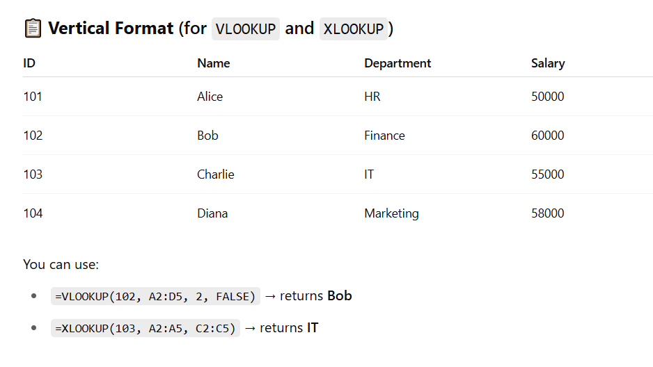

Slide 22
Hlookup
· Syntax: =HLOOKUP(lookup_value, table_array, row_index_num, [range_lookup])
· Looks for a value in the first row of a table and returns a value from a specified row.
· Example: =HLOOKUP("Q1", A1:D3, 2, FALSE) — Looks for Q1 in row 1 and returns value from row 2.

Slide 23
XLOOKUP
· Syntax: =XLOOKUP(lookup_value, lookup_array, return_array, [if_not_found])
· Searches a range or array, returns the item corresponding to the first match it finds.
· Example: =XLOOKUP("Banana", A2:A10, B2:B10, "Not found") — Looks for 'Banana' in A2:A10 and returns matching price from B2:B10.

Slide 24
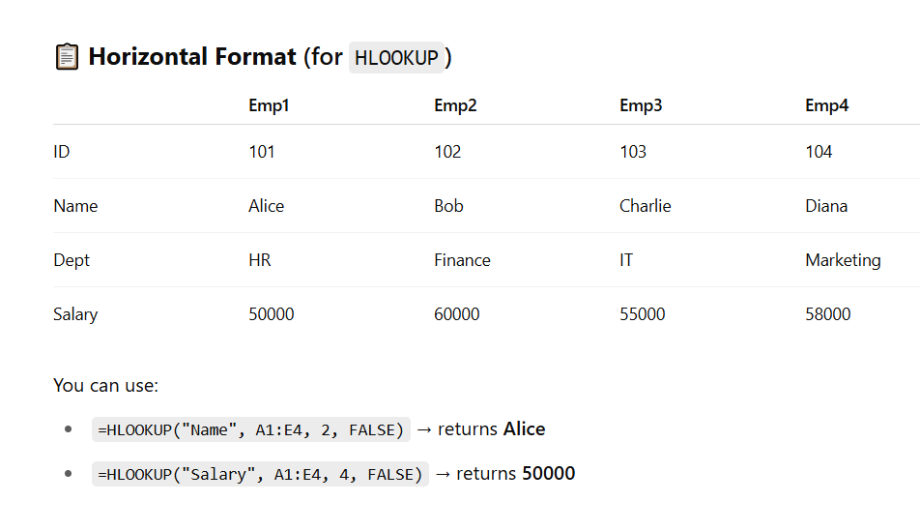

Slide 25
INDEX AND MATCH
· INDEX Syntax: =INDEX(array, row_num, [column_num]) — Returns a value at a specific position.
· MATCH Syntax: =MATCH(lookup_value, lookup_array, [match_type]) — Returns the relative position of an item.
· Combined Example: =INDEX(B2:B10, MATCH(101, A2:A10, 0)) — Looks for 101 in A2:A10, finds its position, then fetches corresponding value from B2:B10.

Slide 26
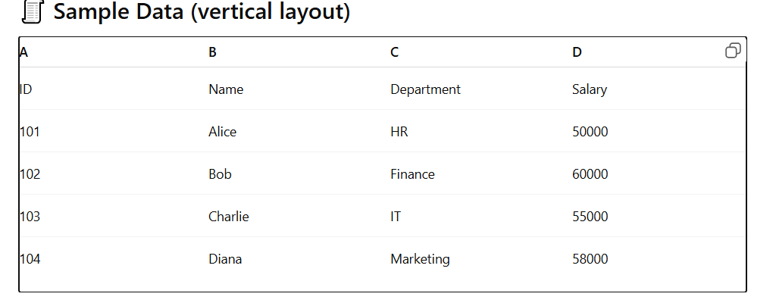

Slide 27
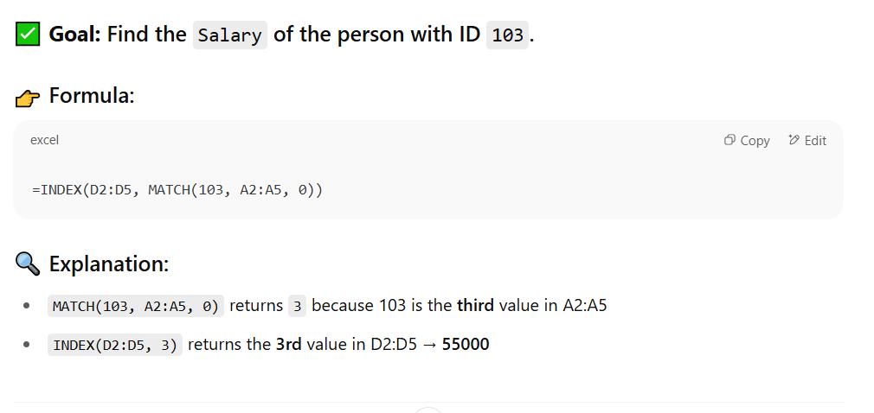

Slide 28
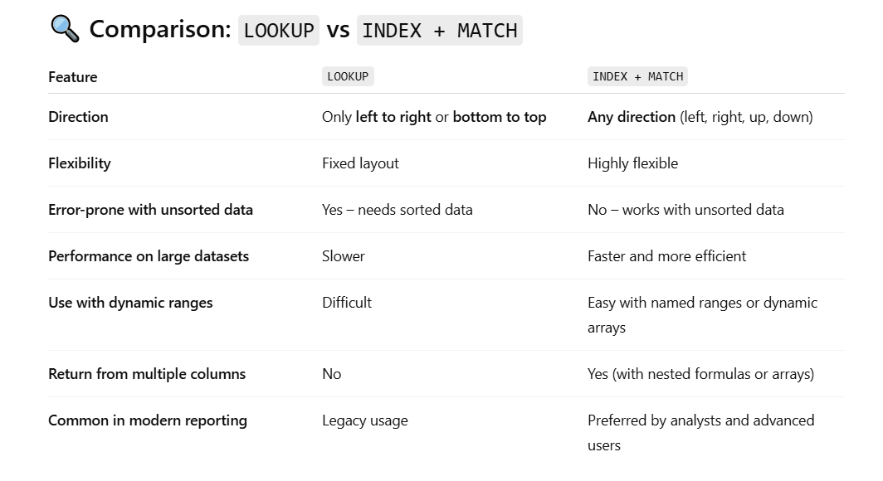

Slide 29
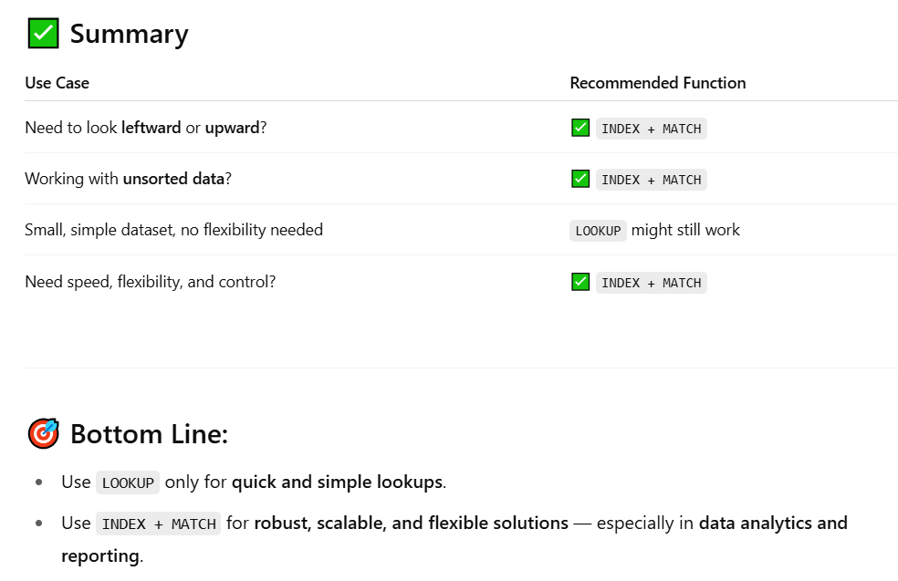

Slide 30
Pivot Table
A Pivot Table is a data summarization tool in Excel that allows you to quickly analyze, explore, and summarize large datasets. You can group data, perform calculations (like SUM, COUNT, AVERAGE), and create dynamic reports — without using complex formulas.

Slide 31
Why use Pivot table?
Summarize data easily from large tables
Group and filter by categories (e.g., by date, product, region)
Perform calculations like totals, averages, or counts without writing formulas
Rearrange (pivot) data to view it from different perspectives
Create dashboards with slicers and Pivot Charts for better data visualization

Slide 32
Basic elements you can add to a pivot table
Fields
Row Labels – E.g., Product names, Dates, Regions
Column Labels – E.g., Years, Categories
Values – E.g., Sales totals, Number of transactions
Filters – E.g., Filter the entire table by Year or Department

Slide 33
2. Slicers
Visual, clickable filters
You can add multiple slicers (e.g., by Region, Product)
Found in: PivotTable Analyze > Insert Slicer
3. Timeline (for Date Fields)
Special slicer just for date fields
Lets you filter by months, quarters, or years
Found in: PivotTable Analyze > Insert Timeline
4. Calculated Fields
Custom formulas inside the Pivot Table
Example: =Profit = Sales - Costs
Found in: PivotTable Analyze > Fields, Items & Sets > Calculated Field

Slide 34
Visualization option
Pivot Charts
Create charts directly from your Pivot Table
Automatically updates when you refresh the Pivot Table
Types: Column, Bar, Line, Pie, etc.
Found in: Insert > PivotChart

Slide 35
Organizational feature
Grouping
Group data like:
Dates into Months, Quarters, Years
Numbers into ranges (e.g., Age: 0–20, 21–40)
Text manually (e.g., group several product types)
Found by: Right-click a field value > Group
7. Sorting
Sort rows or columns by value or label
Example: Sort sales data from highest to lowest

Slide 36
8. Filtering
Use drop-down filters in the Row/Column fields
Combine with slicers for advanced interactivity.
9. Customizing- color , size

Slide 37
Handling Missing/NULL Values in excel
Step 1: Identify Null (Missing) Values: Conditional formatting, Filter blanks
Step 2: Fill or Remove Null Values
Example:
Replace=IF(A2="", "Unknown", A2)

Slide 38
Scenario | Data Type | Example | Best Method(s) | Why?
1. Missing test scores in a student report | Numeric | Blank cell in "Math Score" | Use Mean or Median | Preserves dataset size, avoids dropping students
2. Missing age values in a demographic dataset | Numeric | Blank in "Age" | Use Median | Less sensitive to outliers than mean
3. Missing category in product type | Categorical (Text) | Blank in "Product Type" | Use Mode, or fill with "Unknown" | Mode captures common category; "Unknown" is safe for reporting
4. Blank country or state field in geographic data | Categorical | Blank in "State" | Use last known value (forward fill) or lookup from another source | Location often repeats in sequence; external lookup improves accuracy
5. Missing values due to entry error | Mixed | Inconsistent blanks | Data Validation + Manual Correction | Ensures accuracy before imputation

Slide 39
Scenario | Data Type | Example | Best Method(s) | Why?
6. Missing gender in a form | Categorical | Blank in "Gender" | Replace with "Prefer not to say" or leave as null | Ethically sound when sensitive data is optional
7. Sales data has missing entries only on weekends | Time-series | Gaps in sales per date | Leave null or use 0 if business is closed | Avoid false assumptions from artificial fill
8. IoT sensor data has missing temperature values | Time-series (numeric) | Missing temperature readings | Use linear interpolation or previous value (LOCF) | Preserves continuity in time-series
9. Financial report missing expense entry | Numeric | Blank in "Travel Expenses" | Use historical average or manual input | Financial data needs audit-friendly logic
10. Survey data missing answer for a question | Categorical or rating | Blank in "Satisfaction Rating" | Replace with "No Response", or exclude from analysis | Avoid misinterpreting user intent

Slide 40
Mean:
=IF(ISBLANK(B2), AVERAGE($B$2:$B$100), B2)
➤ Median:
=IF(ISBLANK(B2), MEDIAN($B$2:$B$100), B2)
➤ Mode:
=IF(ISBLANK(B2), MODE.SNGL($B$2:$B$100), B2)
➤ Interpolation (basic linear between two values)
If A2 is date, B2 is value:
=B1 + ((B3 - B1)/2)
(Assumes B2 is missing, and you’re interpolating between B1 and B3)
Interpolation is a method of estimating missing values that fall between two known values in a sequence or time series.
Think of it like connecting the dots:

Slide 41
Logical Conditions
Replace Null Using Logical Conditions
Example: If score is missing and name is "Alice", assign 85, else assign 0
=IF(B2="", IF(A2="Alice", 85, 0), B2)

Slide 42
To handle wrong or null
=IFERROR(value, value_if_error)
=ISBLANK(cell)

